Slide 1
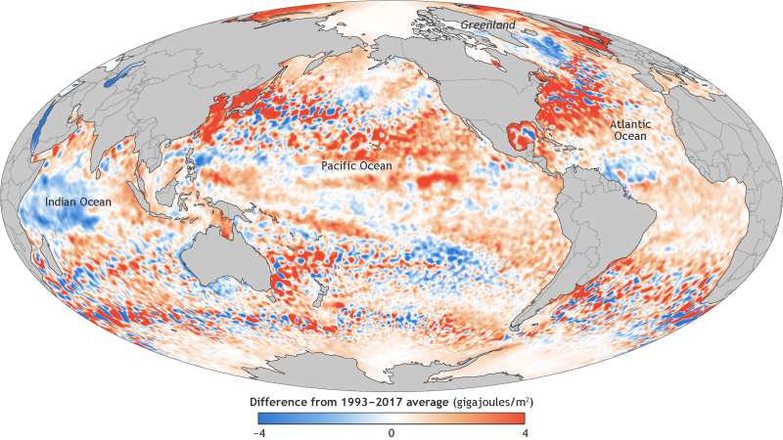
Something to watch for in your GCM runs: geographical inhomogeneity of warming

Slide 2
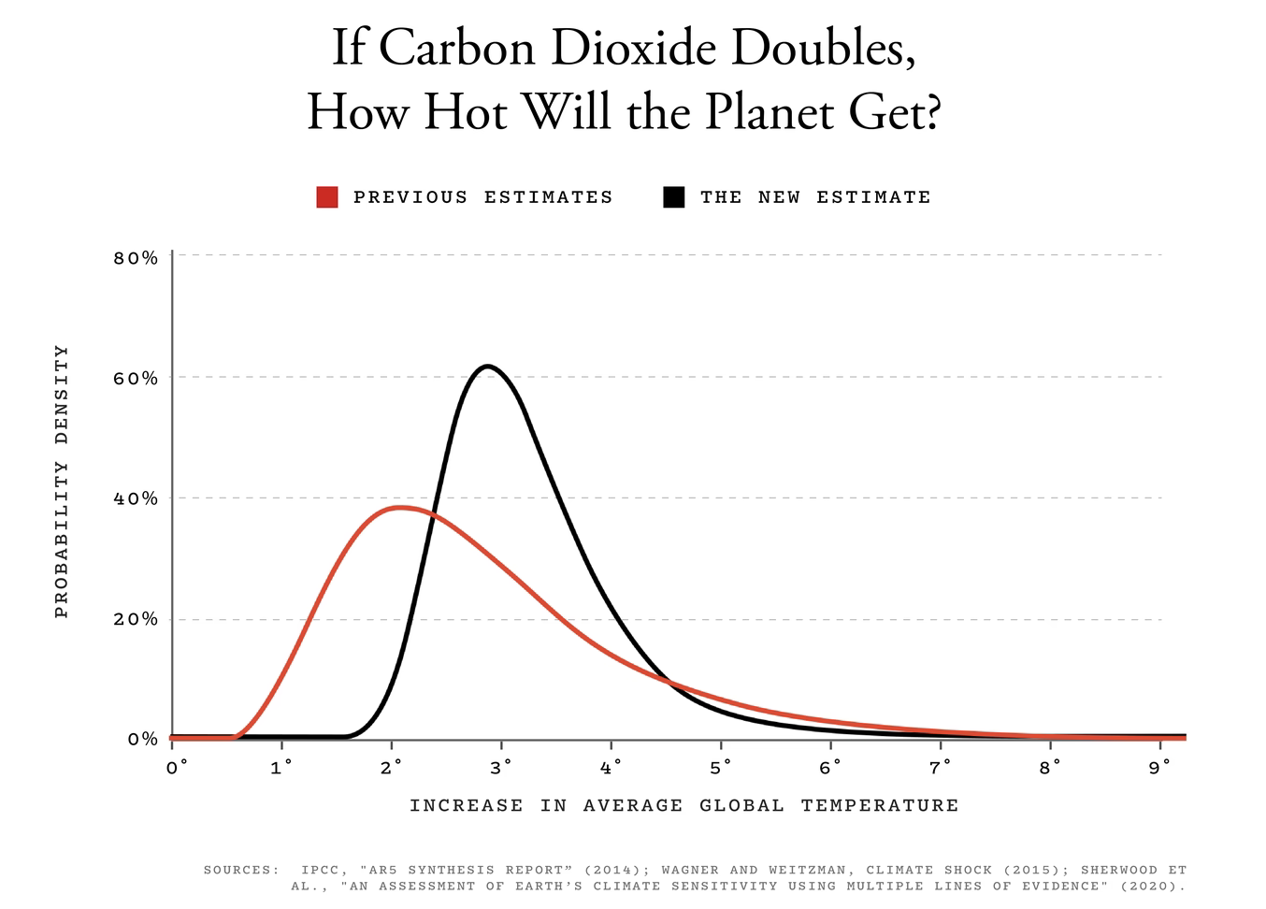
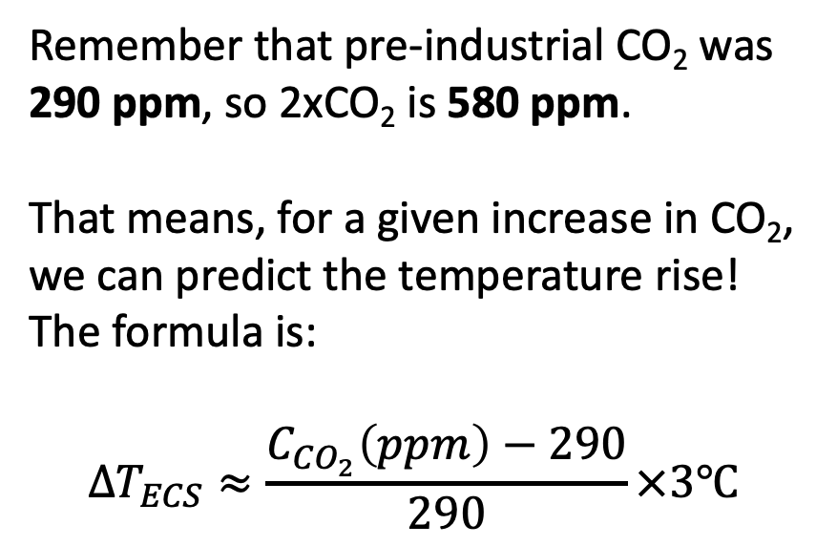
Something to compare to: the $∆T_{ECS}$ (Temperature anomaly according to the Equilibrium Climate Sensitivity formula)
Remember that pre-industrial CO₂ was 290 ppm, so 2xCO₂ is 580 ppm.
That means, for a given increase in CO₂, we can predict the temperature rise! The formula is:
$$∆T_{ECS}≈\frac{C_{CO_{2}}\left(ppm\right)−290}{290}×3℃$$
https://www.theatlantic.com/science/archive/2020/07/a-new-solution-to-climate-sciences-biggest-mystery-sensitivity/614581/

Slide 3
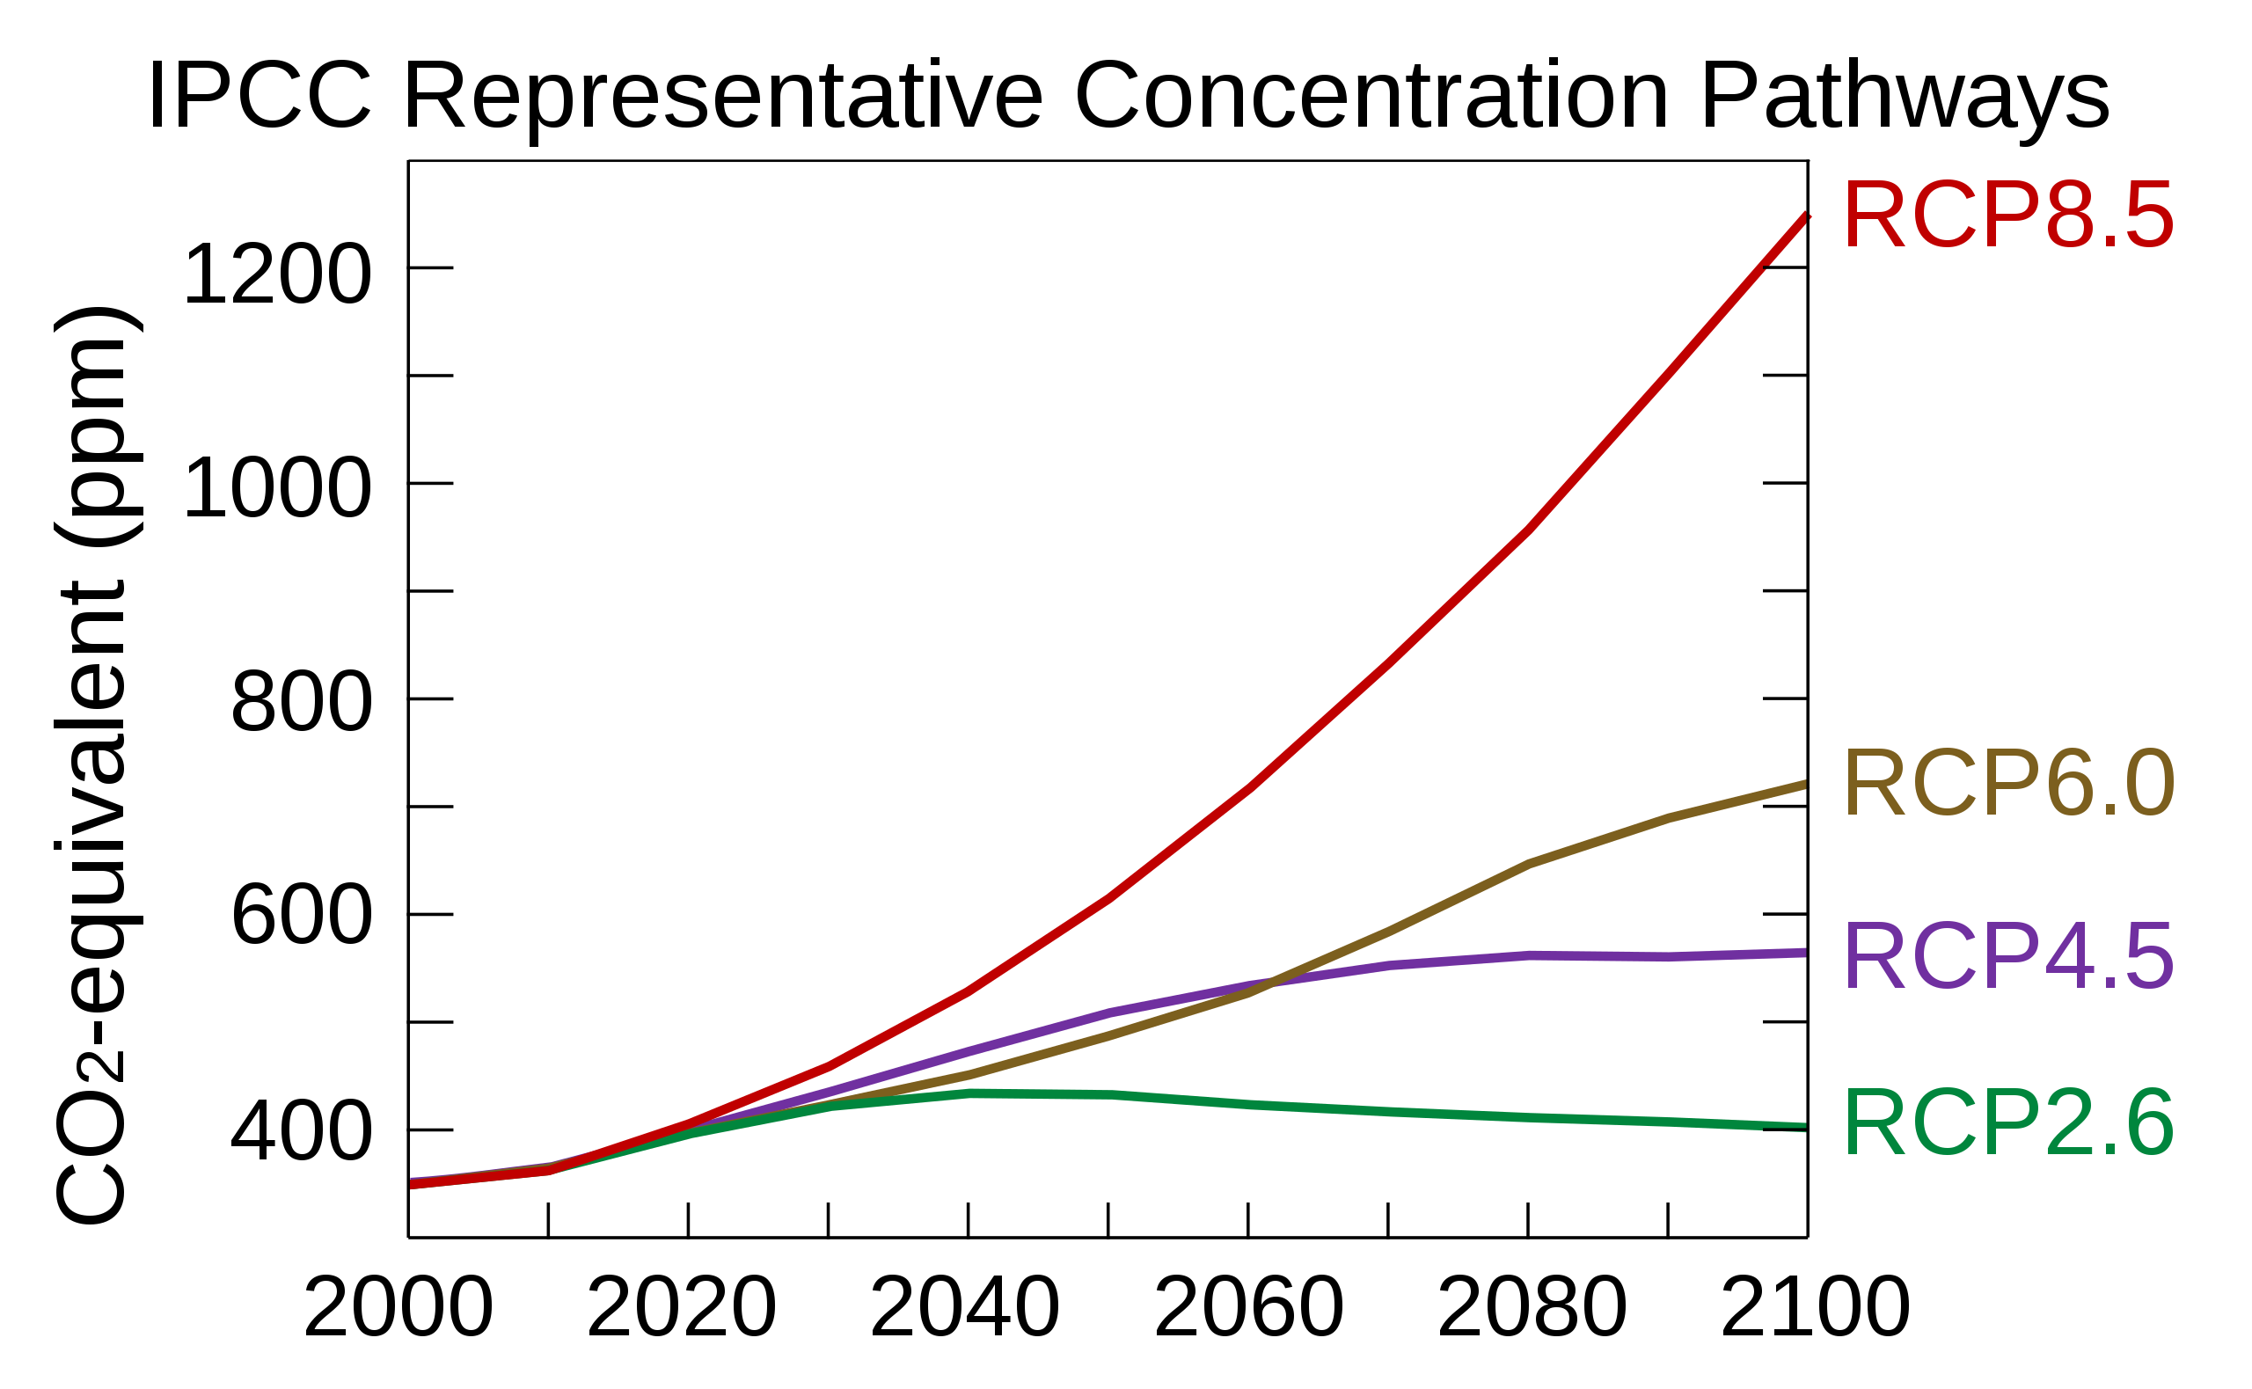
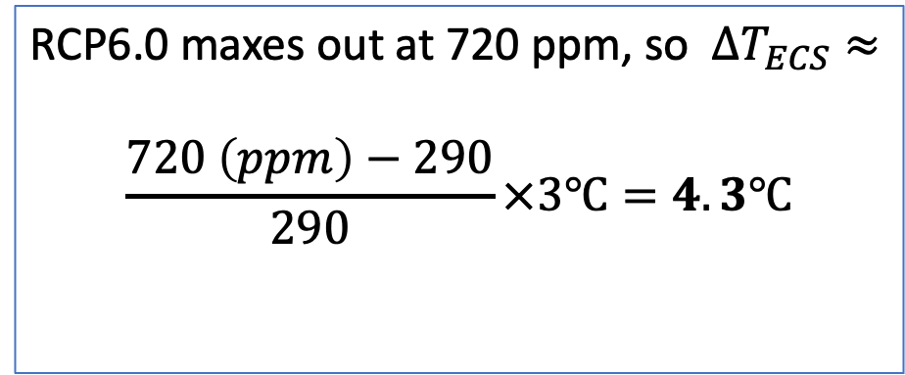
$∆T_{ECS}$ and the representative concentration pathways (RCPs)
RCP6.0 maxes out at 720 ppm, so $∆T_{ECS}≈$
$$\frac{720 \left(ppm\right)−290}{290}×3℃=4.3℃$$
720 ppm
https://en.wikipedia.org/wiki/Representative_Concentration_Pathway

Slide 4
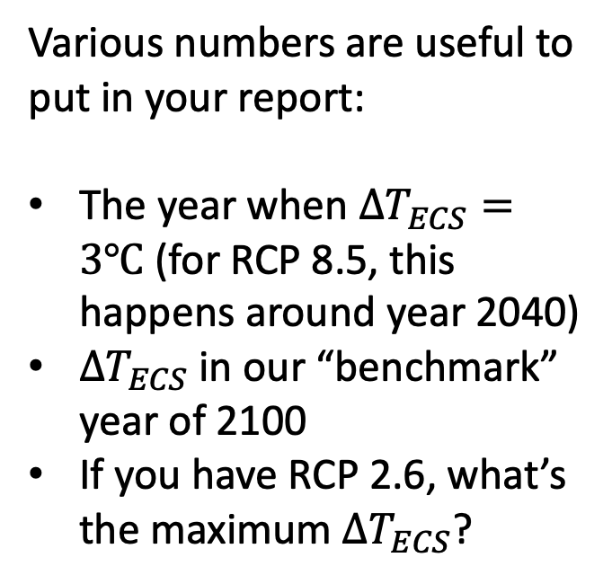
You should calculate $∆T_{ECS}$ for the RCP (or whatever scenario) you are studying. Bear in mind this is for comparison, since your GCM will also predict temperature changes!
Various numbers are useful to put in your report:
The year when $∆T_{ECS}=3℃$ (for RCP 8.5, this happens around year 2040)
$∆T_{ECS}$in our “benchmark” year of 2100
If you have RCP 2.6, what’s the maximum $∆T_{ECS}$?
720 ppm
580 ppm
440 ppm
https://en.wikipedia.org/wiki/Representative_Concentration_Pathway

Slide 5
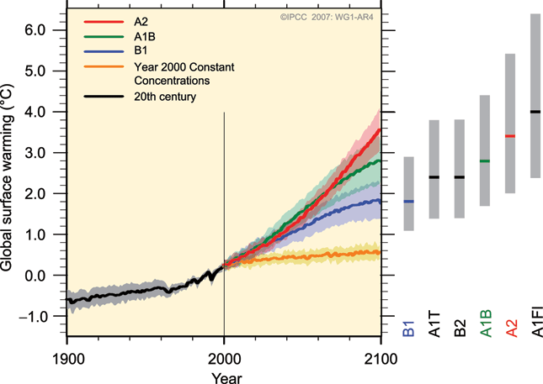
Also, your single GCM runs will not tell you about uncertainties in these predictions

Slide 6
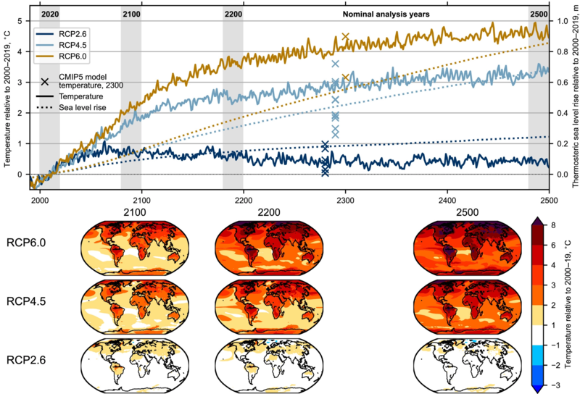
Also, the world goes on past the year 2100
https://en.wikipedia.org/wiki/File:Global_mean_near-surface_air_temperature_and_thermosteric_sea-level_rise_anomalies_relative_to_the_2000%E2%80%932019_mean_for_RCP_climate_change_scenarios.webp

